Slide 1

Toolkit Doc25 Prosilica
Feb 15, 2011

Slide 2
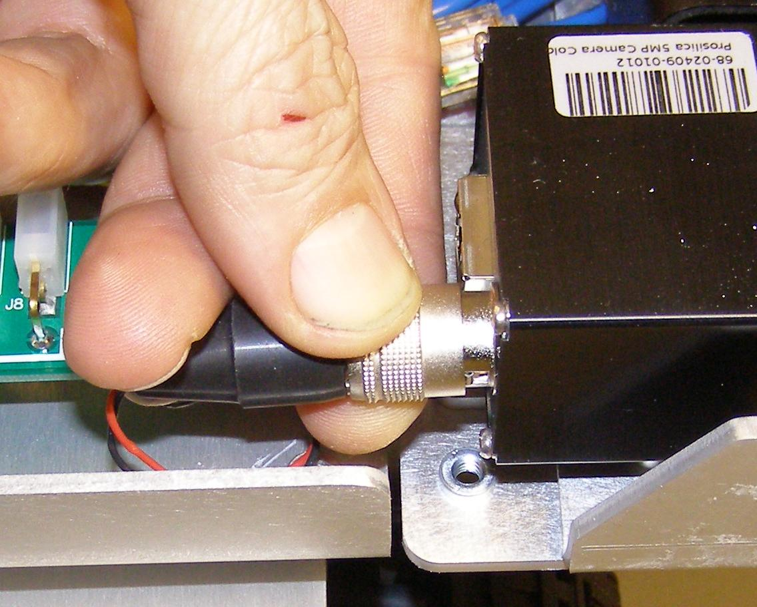
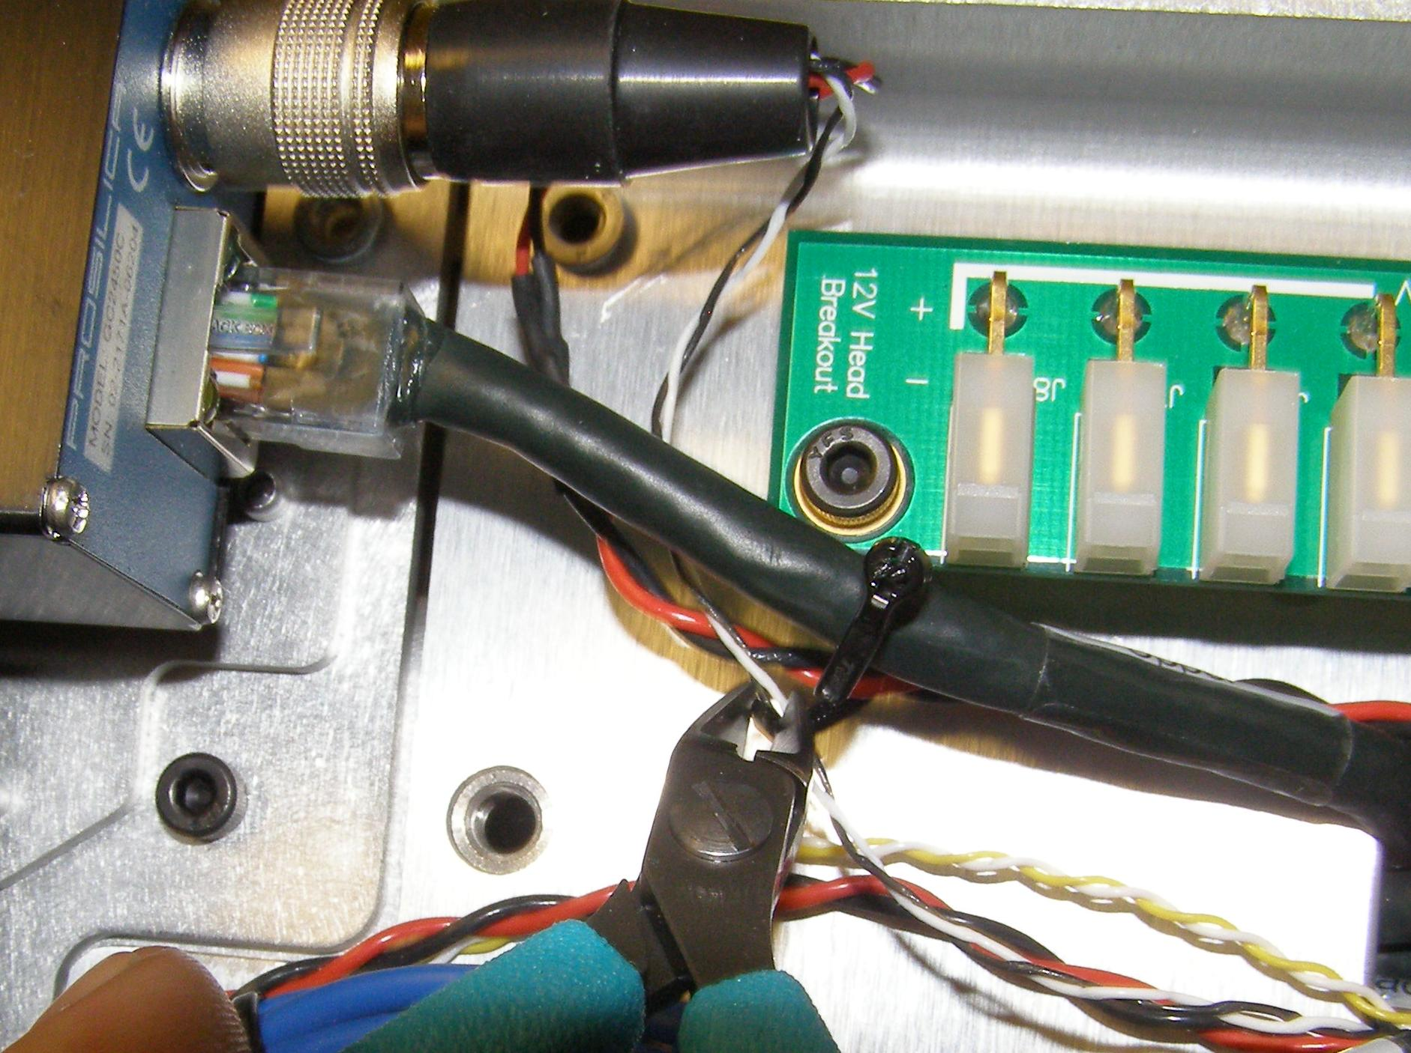
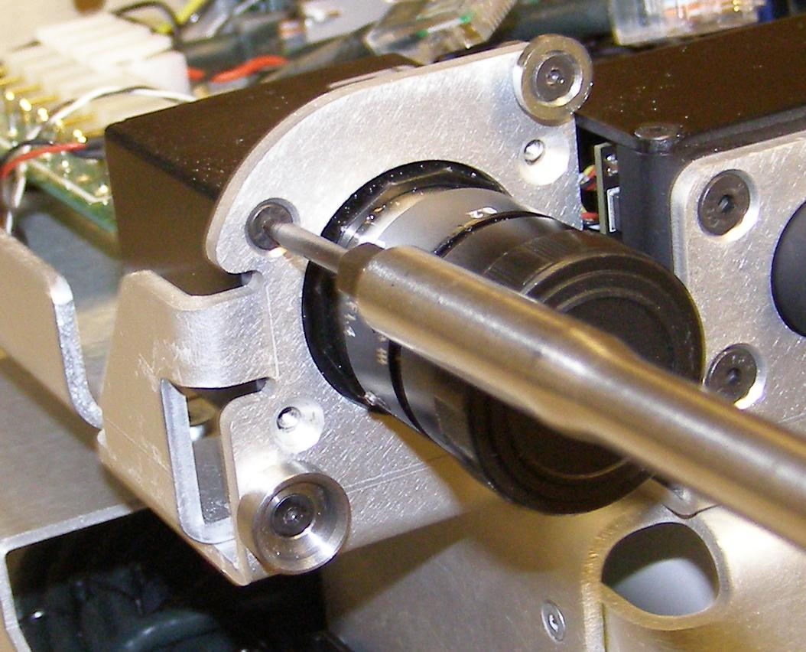
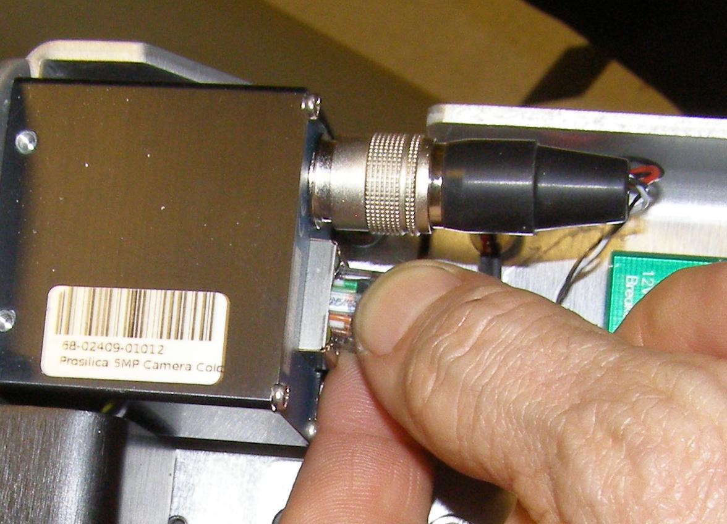
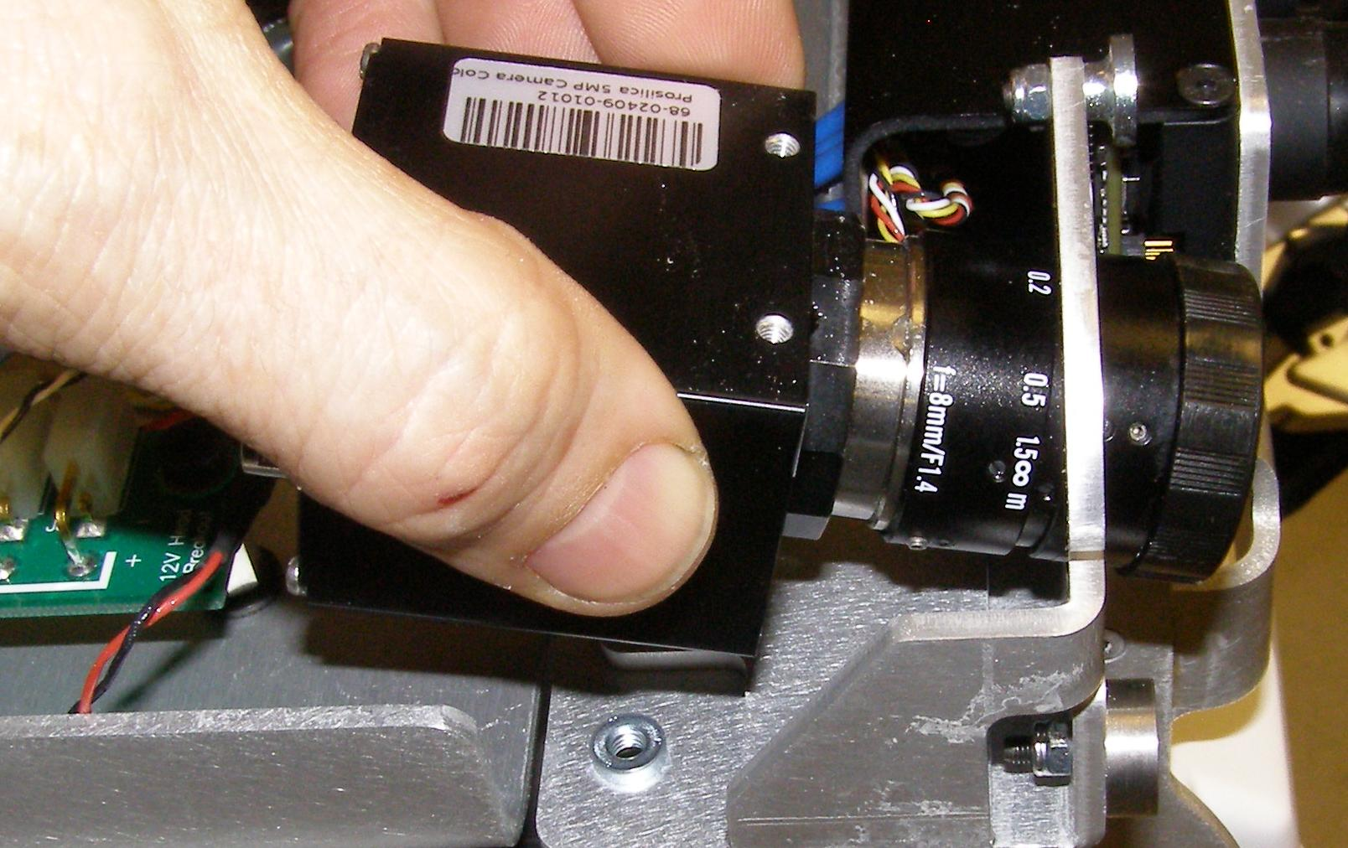
Procilica Camera Remove
Refer to the PR2 Overview document for additionalinformation.
Make sure the Robot is turned off and unplugged from wall power.
Remove the Head Pan Tilt Left. (Doc11)
Remove the Head Pan Tilt Right. (Doc11)
Remove the Head Hatch. (Doc12)
Remove the Head Bezel Rear. (Doc12)
Remove the Head Bezel Front. (Doc12)
Remove the Head Bonnet. (Doc12)
Cut the tie-wrap holding the Prosilica Ethernet and power cables together. (Fig. 1)
Disconnect the Ethernet jack from the back of the Prosicilica. (Fig. 2)
Disconnect the Power Plug by pulling backwards on the knurled ring. (Fig. 3)
Using the 2mm bit together with the T-handle driver, remove the 4 mounting screws. (Fig. 4)
Lifting the back of the camera, remove the camera from the rear being careful not to damage the lens assembly. (Fig. 5)
Fig 3
Fig 1
Fig 4
Fig 2

Slide 3
Procilica Camera Install
Reverse the removal procedure.
Carefully feed the camera lens through the mounting hole.
Using Loctite 248, install the 4 screws and torque to 1.36Nm using the Large torque driver.
Plug the Power Plug back in the camera being careful to rotate and align the connector correctly. The knurled ring will snap forward when the connector is correctly installed.
Plug the Ethernet RJ45 jack in.
Tie-wrap the Ethernet and Power cables to the standoff at the end of the 12V Head Breakout board.
Follow the installation procedures in Doc11 and Doc12 to reassemble the Head covers.

